Slide 1
CSS
MCNDHS
Ms. Eng

Slide 2
AIM: WHAT IS THE NTH-CHILD SELECTOR?
Do now:
Daily Grade:
On-time/attendance/not leaving the classroom: 25%
Cellphones: 25%
Notes:25%
Classwork/Homework: 25%

Slide 3
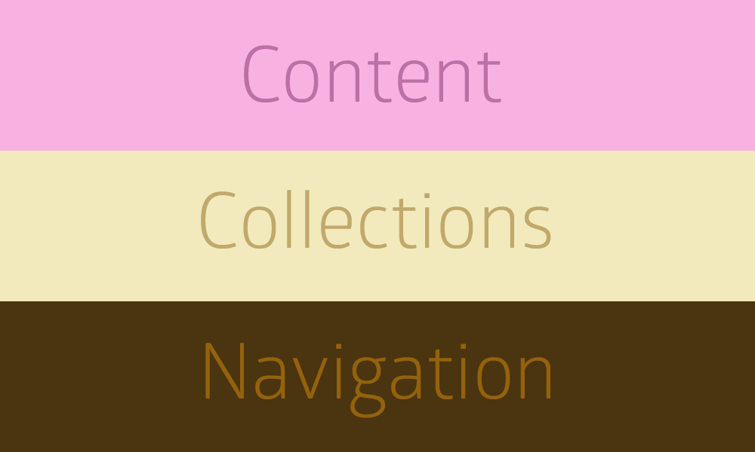
WHAT ARE WE LEARNING TODAY:

Slide 4
NTH-CHILD OPTIONS: SPECIFIC LINES
element: nth-child(specific line){
}

Slide 5
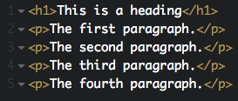

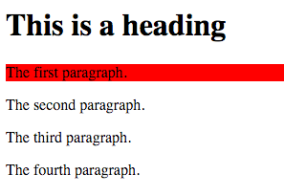
EXAMPLE:

Slide 6
NTH CHILD OPTION: ODD AND EVEN
element: nth-child(even){
}
element: nth-child(odd){
}

Slide 7
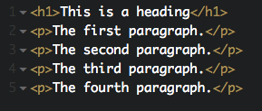
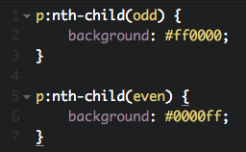
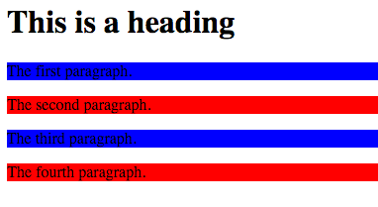
EXAMPLE:

Slide 8
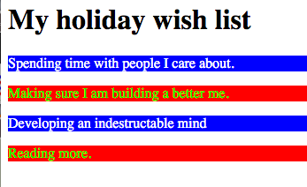
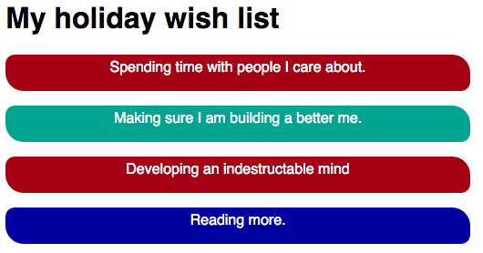
ACTIVITY
to get credit:
for extra credit:

